Slide 1
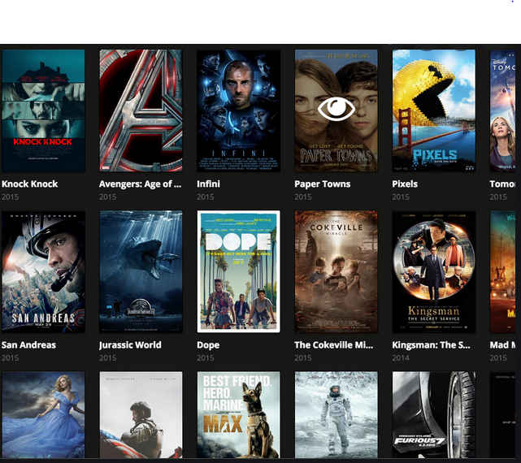

Quarterly Business Insights
Rockbuster Stealth
Presented by : Alankar Dhumal
Data Analytics Team
11-Jan-2022

Slide 2
Today’s Agenda
Data Profiling
Top 10 Countries by Revenue
Top 10 Countries by Customer counts
Top 10 Countries by Revenue
Revenue per Customer
Film Category Performance
Film Title Performance
Global Outlook

Slide 3

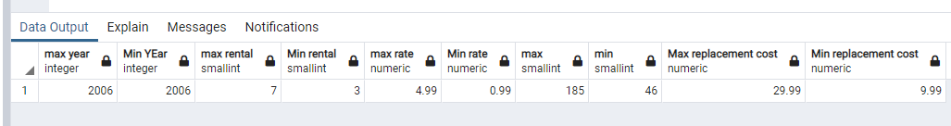
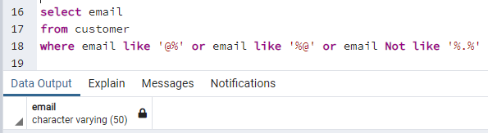
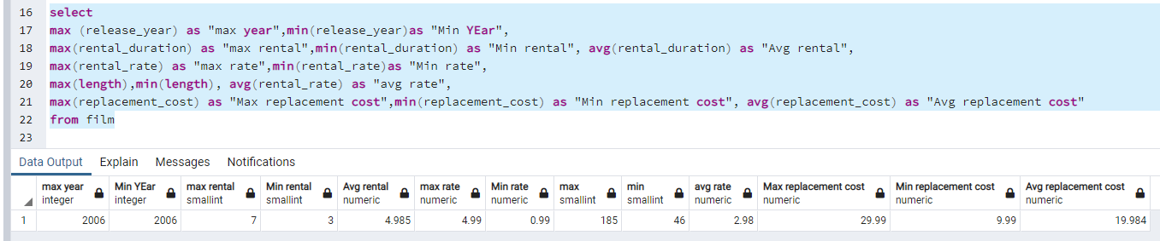
Data Profiling
All numeric values checked and found ok
All email IDs checked using the following query and found ok
All descriptive statistics checked and found ok

Slide 4
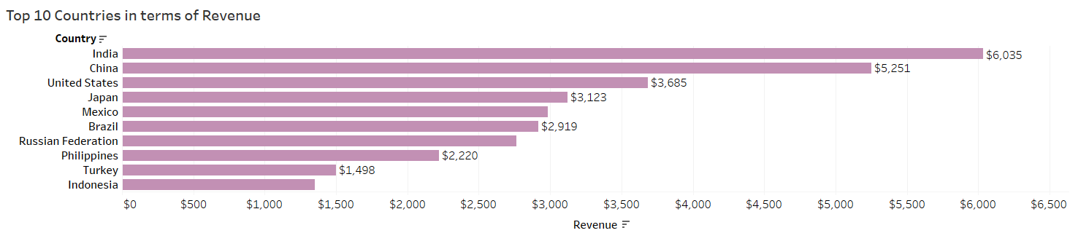
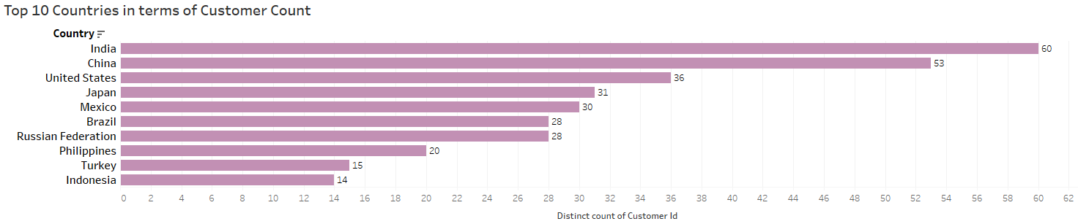
Top-10 Countries

Slide 5
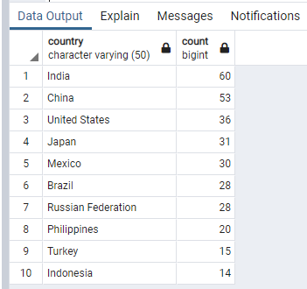
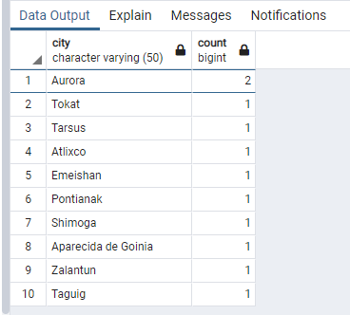
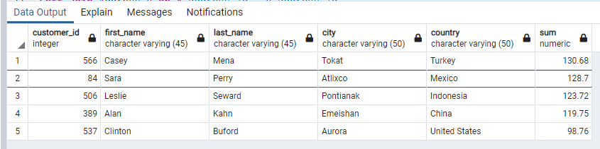
Top-10 (SQL Query Results)
Top 10 Countries
Top 10 Cities
Top 5 Customers

Slide 6
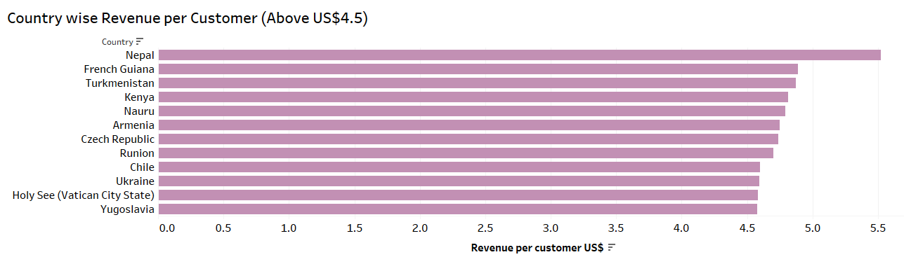

Countries by Revenue per Customer- (above US$4.5)
Introduce more content in local language
Introduce more titles with local language sub-titles

Slide 7
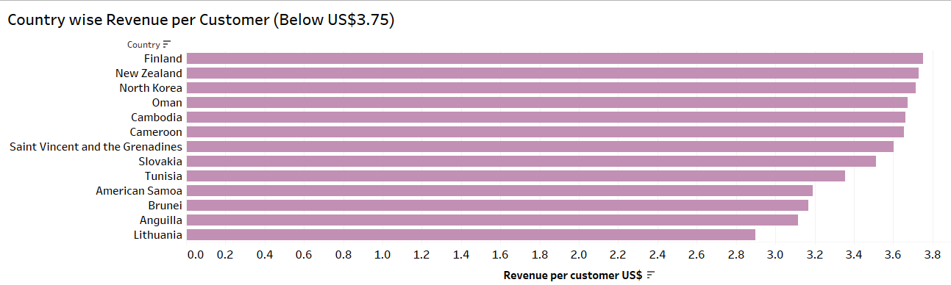
Revenue per Customer- below US$3.75
Survey the market for customer feedback
Introduce promotions
Further research the market

Slide 8
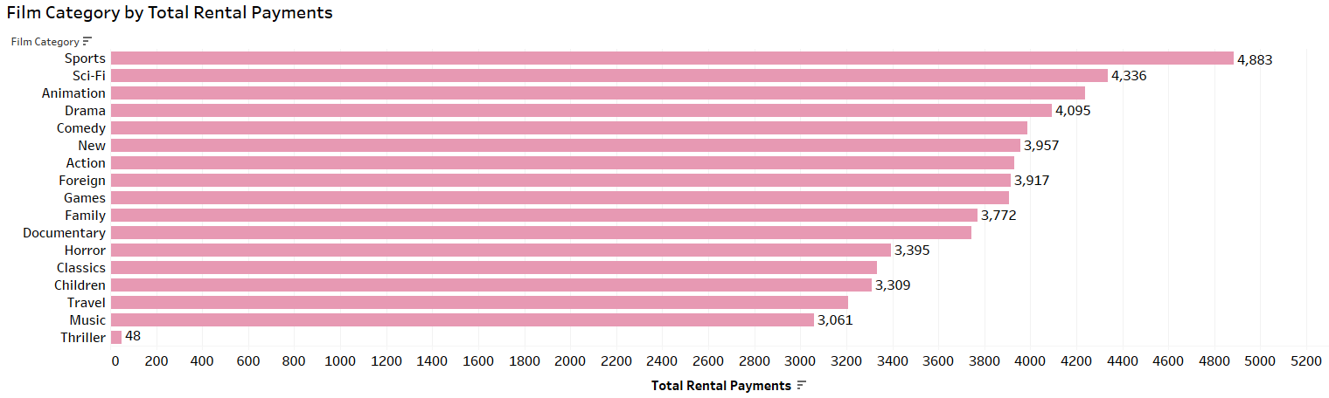

Film Category Performance
Reconsider licensing the current movies in Thriller Category

Slide 9
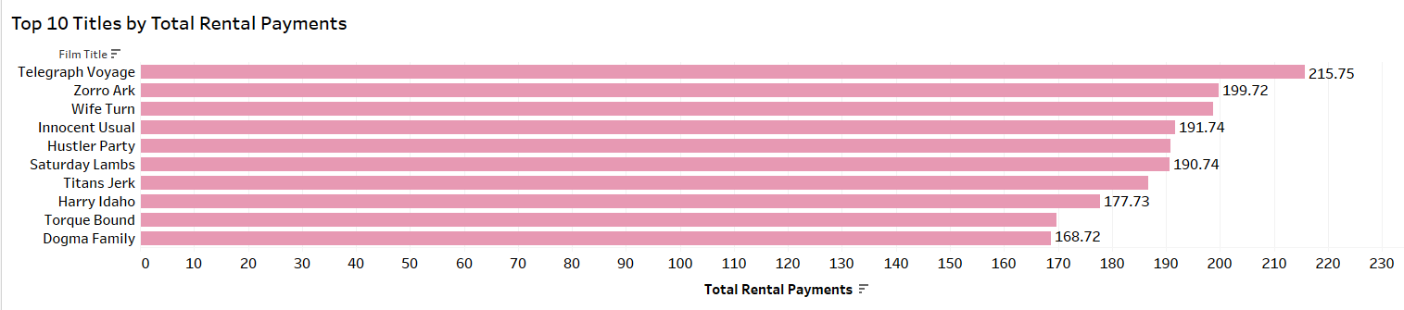
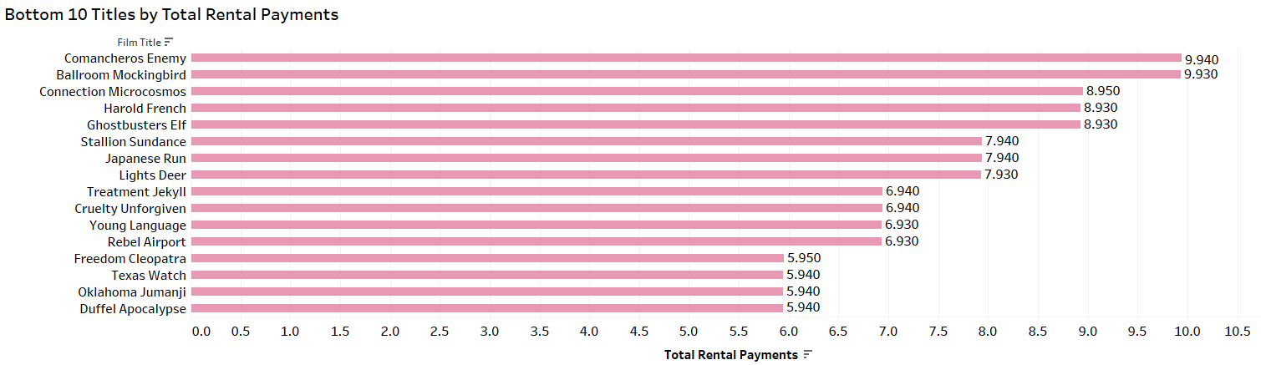
Film Titles by Total Rental Payment
Reconsider licensing these movies

Slide 10
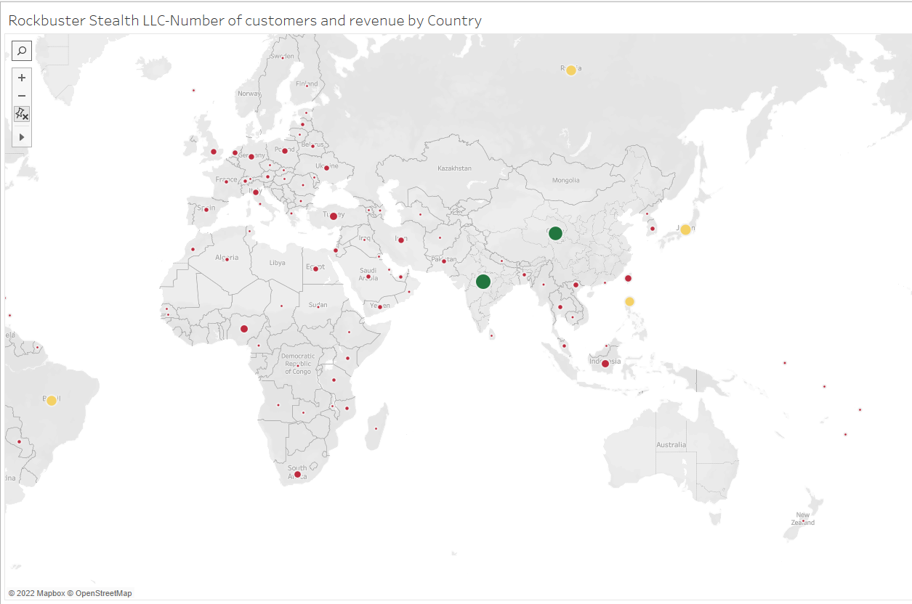
Global Outlook
https://public.tableau.com/app/profile/alankar2299/viz/RockbusterStealthLLC_16419117266190/Spatial?publish=yes

Slide 11


Thank you

